Slide 1

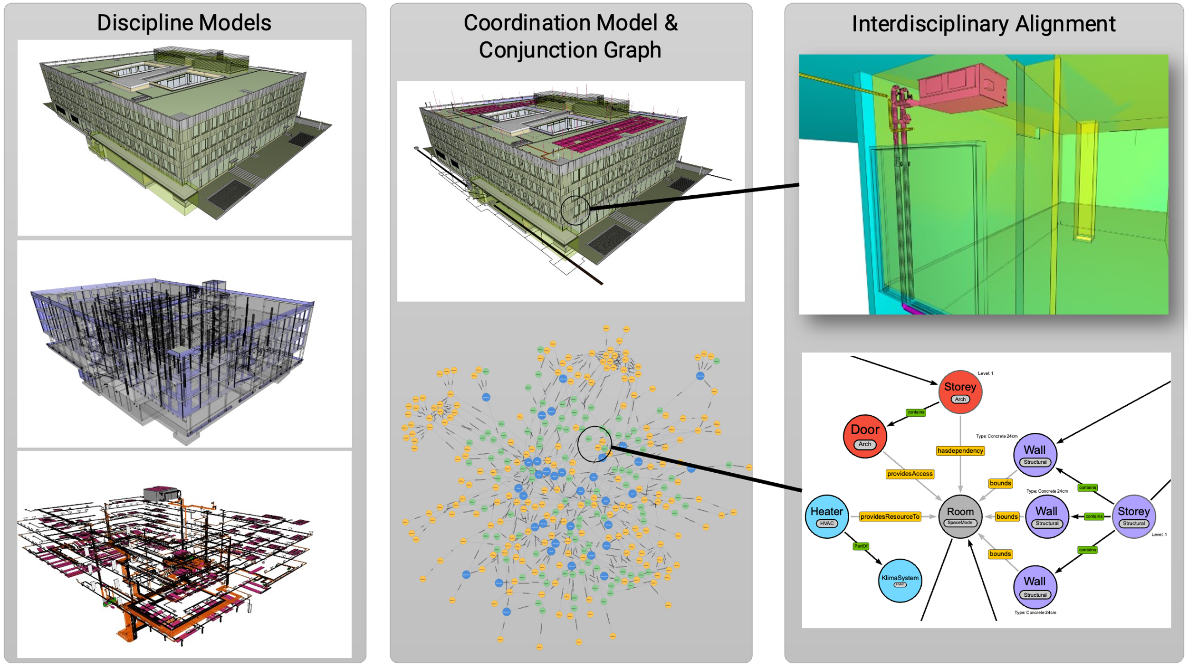
Building Integration and Graph Analytics:
A Digital Twin Approach using Labeled Property Graphs
Project Characteristics
Task
This software lab utilizes Solibri, Ifcopenshell, and other tools to extract and interact with adjacencies from diverse IFC models. Participants will then use CYPHER to integrate this data into a comprehensive graph, utilizing Neo4j and the Graph Data Science library for construction and exploration.
GENERAL INSTRUCTIONS:
Understand IFC standards and essential BIM
concepts.
Employ suitable programming languages and
libraries for geometry processing.
Leverage Neo4j for effective graph database
implementation.
Experiment with Cypher queries and
Neo4j Graph Data Science Tools
for comprehensive graph data science.
Highlight the importance of querying
and managing data for informed decision-making
in complex spatial structures.
Modeling:
Mathematics:
Programming:
Science:

